Slide 1
G2M case study
Virtual internship
15-8-2021

Slide 2
Background
XYZ is a private equity firm in US. Due to remarkable growth in the Cab Industry in last few years and multiple key players in the market, it is planning for an investment in Cab industry.
The analysis :
Preparing the data and understanding the data
Profit and customers of each cap in each year and each city
Check if there is a slice of people how use a specific cap.
Find the profitable company

Slide 3
Data exploration
14 Features( including 9 derived features)
Timeframe of the data: 2016-01-31 to 2018-12-31
We have added more 4 features that we gonna use
Years
Months
Days
profit

Slide 4
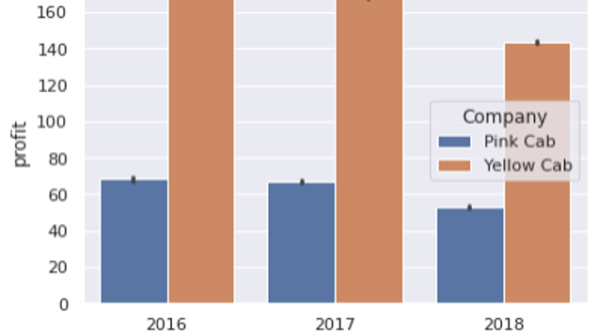
Profit per trip
It appears that yellow cap makes more profit per trip in all the three years.

Slide 5
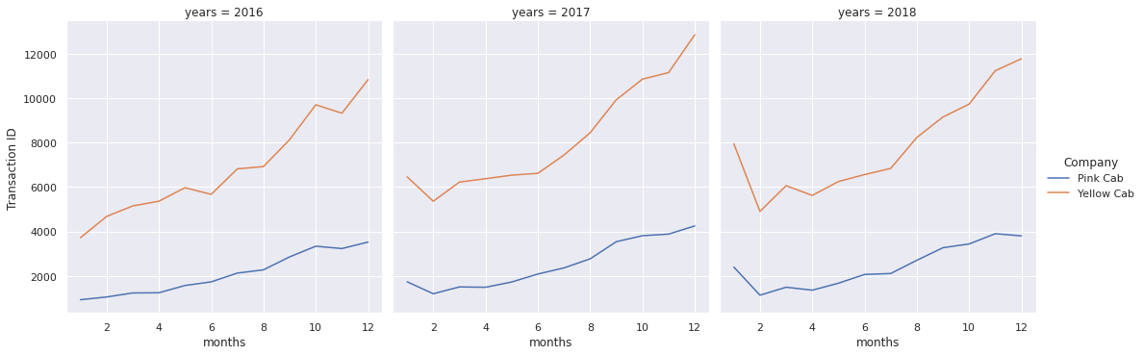
Number of transactions per month
Yellow cap has higher number of transactions per year in all the three years while both of them make more trips in the second half of the year more than the first half.

Slide 6
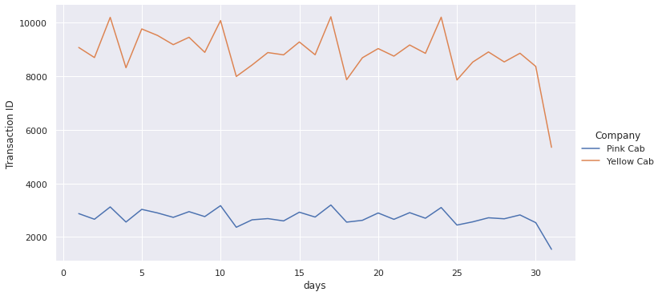
Number of transactions per day
Yellow cap has more number of transactions in all days Both of them have low number of trips in the last days of the month and that is due to that most of the people get paid at the begining of the month

Slide 7
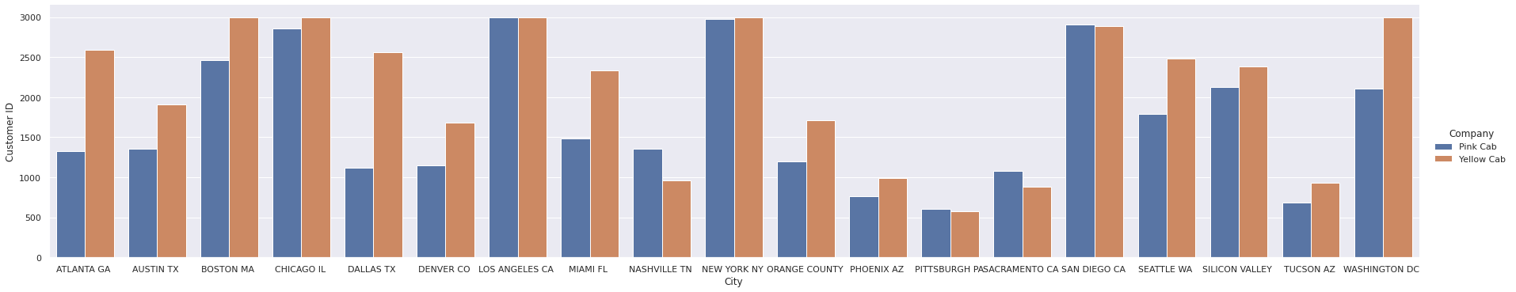
Profit per City
It appears that "yellow cap" has more customers in 16 cities while "pink cap" has more customers in just 3 Cities

Slide 8
Customer analysis
I tried to find if there is any difference in the type of people who use each company according to
Gender
Age

Slide 9
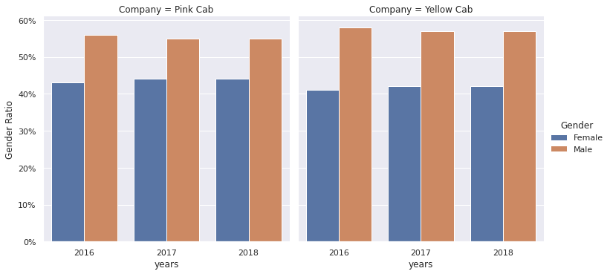
Gender basis analysis
In both companies the ratio of males is higher than the ratio of females

Slide 10
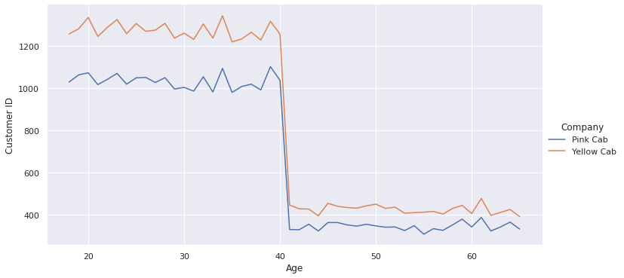
Age basis analysis
it appears that from age 40 or more make less profit in both company

Slide 11
conclusion
Customer Reach: Yellow cab has higher customer reach in 16 cities while Pink cab has higher customer reach in 4 cities.
Average profit per trip: yellow cap has about 3 times more profit than pink cap
Average profit per km: yellow cap has about 3 times more profit than pink cap
On this basis we recommend yellow cap for investment.

Slide 12
THANK YOU

